Slide 1
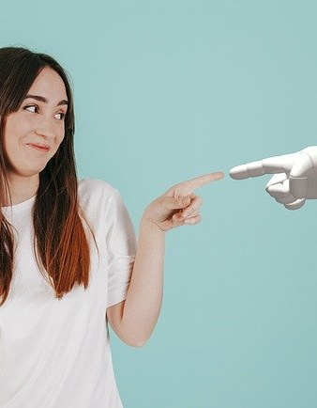

Toon-e-motion
Toon-e-motion is a special algorithm of Artificial intelligence to convert daily life picture videos and portraits into anime or cartoon

Slide 2
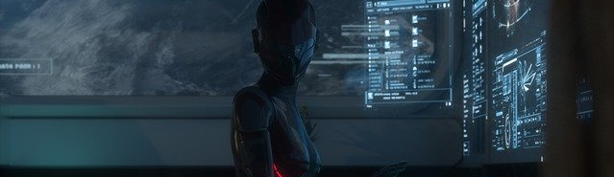
Team Members
Muhammad Azeem
Muzammil Ahmad
Umair Talib
Ayesha

Slide 3
The aim of portrait cartoon stylization is to transform real photos into cartoon images with portrait ID information and texture details. The frame-by-frame editing of the animation generation process is very costly and time-consuming. And the traditional computer vision-based techniques to tonify images are not accurate.
Problem
Statement
Aim to convert all the real time frames into cartons images with the help of AI using Pytorch and GAN (Generative Adversarial Network)
Aim to convert image or frame into cartoons achieve accuracy 100% such as all the body and background as well.

Slide 4
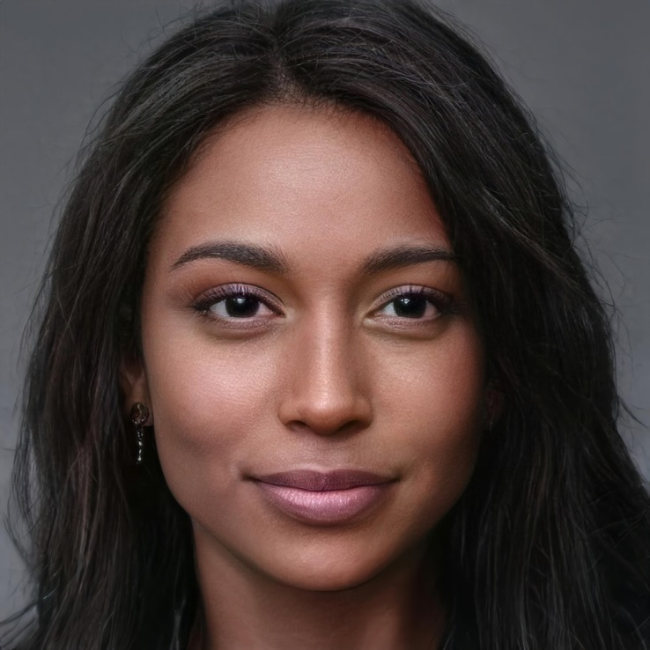
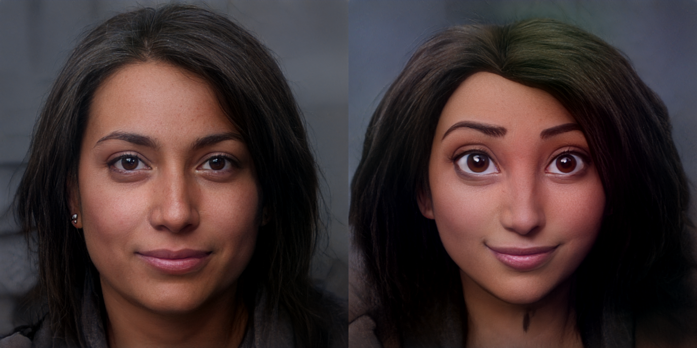
Main Idea
The aim of the project is to put forward a solution for transforming snapshots or videos of real-world into animated photos (Cartoon Images) or videos. The earlier method of transformation requires complicated computer graphics and skills.

Slide 5
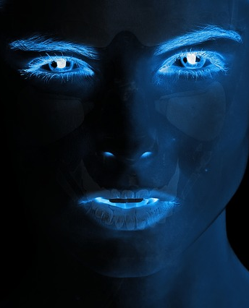
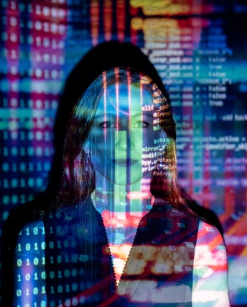
Main Features
The main feature of this project is to put forward a solution for transforming snapshots or videos of real-world into animated photos (Cartoon Images) or Video.
The main feature that we used in this project is GAN.
We use the Generative Adversarial Network method to realize the mapping of the picture to cartoon.

Slide 6
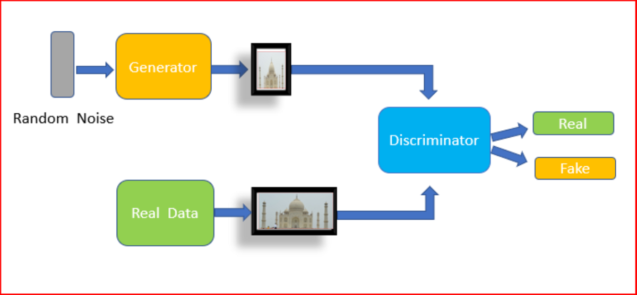
Generative Adversarial Network (GAN)

Slide 7
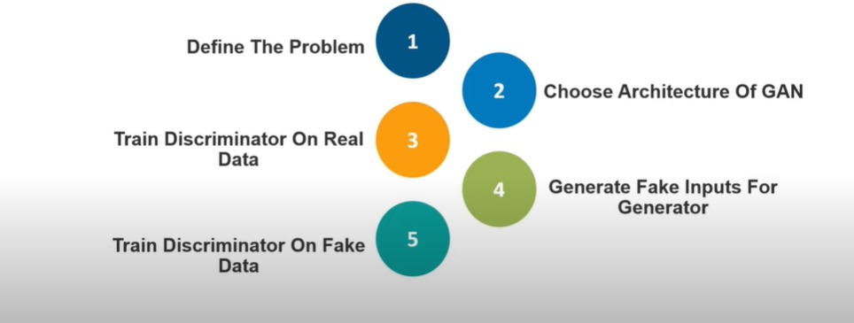
Generative Adversarial Network (GAN)

Slide 8
Project Flow
Frames
4
Converge
1
Video convert into multiple frames
All the new frames again convert into Video and saved in folder
Take video Input
Convert
All the frames pass through GAN and each frame convert into Cartoon like image
Using Open CV
2
5

Slide 9
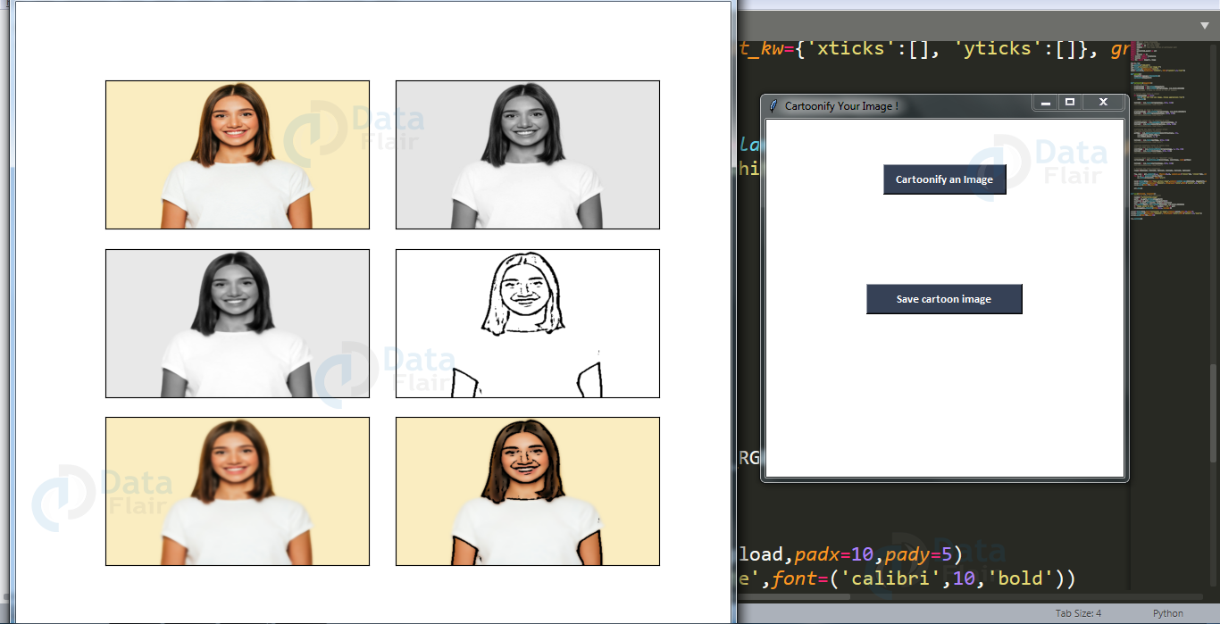
Process Flow

Slide 10
Tools And Technologies
Python 3.0
Jupyter
OpenCV, TensorFlow with PyTorch
PC/Laptop with Nvidia GPU Support (minimum 2GB Recommended) you also use Colab
Google Colabs (for training deep learning model on Google Compute)

Slide 11
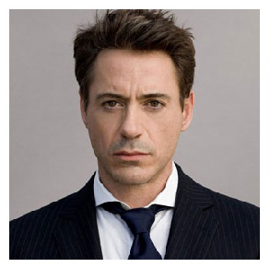
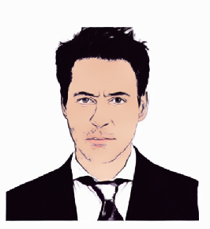
Demo

Slide 12
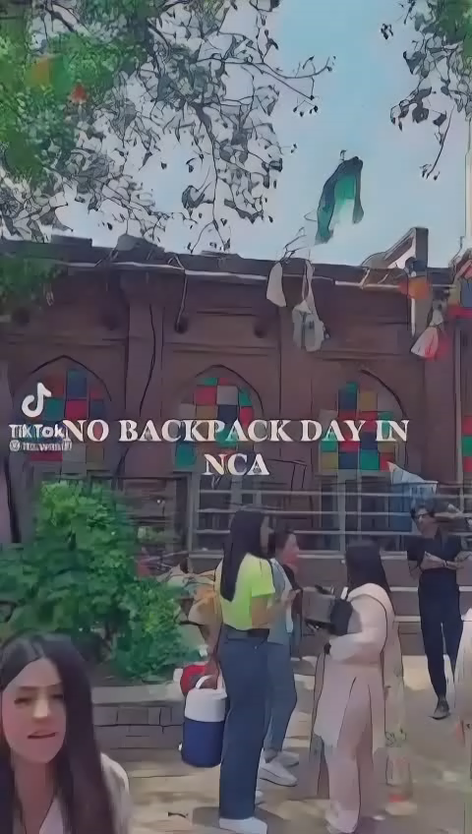

Slide 13
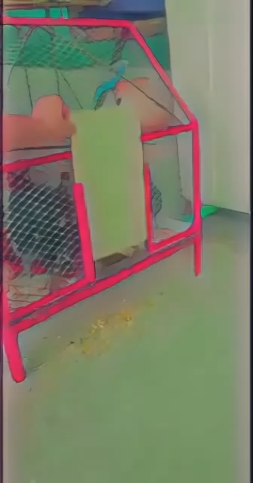

Slide 14
Conclusion
In this project, with the help of Cartoon GAN, which is used to transform images (snapshots) to the finest cartooned image(animated image ). Also with the help of CV2 which is known as Computer vision, we have transformed video into animation(cantonized video).Generating animation from the real image with cartoon look is very important in the movie and animation industry. This work will help the industry to generate animation faster and efficiently and help further research in this direction

Slide 15
THANKS

